Slide 1


Zomato Restaurant Aggregation and Analysis using Power BI
Presented By
Student Name:Khan Affan Mohammed usama
College Name:Walchand institute of technology solapur
Department:computer science & engineering
Email ID:maakhan2109@gmail.com

Slide 2
OUTLINE:
Problem Statement (Should not include solution)
Proposed System/Solution
System Development Approach (Technology Used)
Algorithm & Deployment
Result (Output Image)
Conclusion
Future Scope
References

Slide 3
Problem Statement:
Restaurants and food delivery platforms collect massive amounts of data. However, analyzing this data manually is difficult and time-consuming.
The challenge is to transform raw restaurant data into meaningful insights that can help identify:
Popular cuisines
Top-rated restaurants
Restaurant distribution by city
Price range trends
Power BI dashboards can help visualize and analyze these patterns effectively.
.

Slide 4
Proposed Solution:
The solution involves collecting restaurant data from the Zomato dataset and performing data preprocessing, analysis, and visualization to understand restaurant trends and customer preferences.
Key Components of the Proposed Solution
1. Data Collection The Zomato dataset containing restaurant information such as restaurant name, city, cuisines, ratings, votes, and cost for two is used as the primary data source.
2. Data Cleaning and Transformation Data preprocessing is performed using Power Query to:
Remove duplicate records
Handle missing values
Standardize city and cuisine names
Convert columns into appropriate data types
3. Data Modeling Relationships and calculated measures are created using DAX (Data Analysis Expressions) to enable efficient analysis.

Slide 5
4. Dashboard Development Interactive dashboards are created in Power BI to visualize key insights such as:
Restaurant distribution by city
Most popular cuisines
Rating distribution
Price range comparison
5. Insight Generation The dashboards help identify patterns in restaurant performance, customer preferences, and pricing trends.
Expected Outcome
The proposed solution will provide an interactive and easy-to-understand visualization of restaurant data, enabling better understanding of market trends and helping businesses make data-driven decisions.

Slide 6
System Approach:
The system development approach for this project focuses on data collection, preprocessing, analysis, and visualization using modern data analytics tools. The project was implemented using Business Intelligence techniques to transform raw Zomato restaurant data into meaningful insights.
Technologies Used
1. Microsoft Power BI Power BI is the main tool used for data analysis and visualization. It enables the creation of interactive dashboards and reports that help understand restaurant trends, ratings, cuisines, and pricing patterns.
2. Power Query Power Query is used for data cleaning and transformation. It helps in removing duplicates, handling missing values, and preparing the dataset for analysis.
3. DAX (Data Analysis Expressions) DAX is used to create calculated columns, measures, and aggregations such as total restaurants, average rating, and total votes.
4. Data Visualization Techniques Various visual elements are used in Power BI dashboards including:
Bar Charts
Pie Charts
Line Charts
Maps
Slicers and Filters
These visualizations help present data insights in a clear and interactive way.

Slide 7
5. Dataset (Zomato Restaurant Data) The dataset includes restaurant details such as:
Restaurant Name
City
Cuisines
Rating
Votes
Average Cost for Two
Price Range
Development Approach
The project follows a step-by-step analytics workflow:
Data Collection
Data Cleaning using Power Query
Data Modeling using DAX
Dashboard Development in Power BI
Insight Generation and Analysis
This approach ensures that the data is properly processed and visualized to support effective decision-making.

Slide 8
Algorithm & Deployment:
Algorithm (Workflow of the System)
The algorithm represents the step-by-step process used to analyze the Zomato dataset and generate insights using Microsoft Power BI.
Steps of the Algorithm
Start
Load Dataset: Import the Zomato restaurant dataset into Power BI.
Data Cleaning: Use Power Query to remove duplicates, handle missing values, and standardize columns.
Data Transformation: Convert columns into appropriate data types and split cuisine categories if required.
Data Modeling: Create calculated columns and measures using DAX (Data Analysis Expressions).
Create Visualizations: Develop charts, graphs, and dashboards to represent:
Restaurant distribution by city
Popular cuisines
Rating analysis
Price range comparison
Generate Insights: Analyze patterns and trends in restaurant data.
Display Interactive Dashboard
End

Slide 9
Deployment
Deployment refers to making the developed Power BI dashboard accessible to users for analysis and decision-making.
Deployment Process
1. Dashboard Creation The final dashboard is created using Microsoft Power BI with interactive charts, filters, and slicers.
2. Report Publishing The completed report is published to Microsoft Power BI Service, which allows users to access the dashboard online.
3. Data Refresh The dataset can be refreshed periodically to update the dashboard with the latest restaurant data.
4. User Access Users can view the dashboard through:
Web browser
Mobile devices
Shared reports or links
Benefits of Deployment
Easy access to restaurant analytics
Interactive data exploration
Real-time insights for better decision-making

Slide 10
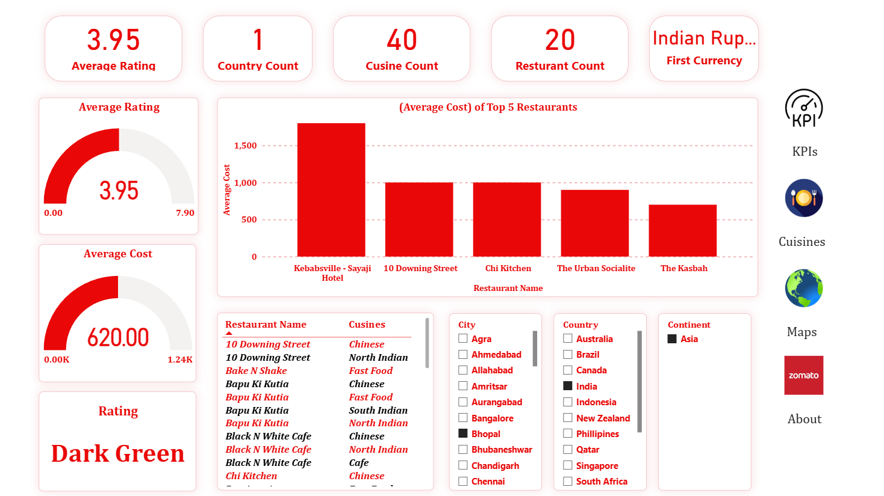
Result:
KPI Dashboard Analysis
The KPI dashboard created using Microsoft Power BI provides an overview of the restaurant dataset.
Key insights from the dashboard include:
• The average restaurant rating is 3.95, indicating overall good customer satisfaction. • The dataset contains 20 restaurants available in the selected region. • A total of 40 different cuisines are offered by restaurants. • The average cost for two people is approximately ₹620. • The dashboard also displays the top 5 restaurants based on average cost.
Interactive filters allow users to analyze restaurant data by city, country, cuisine, and continent.

Slide 11
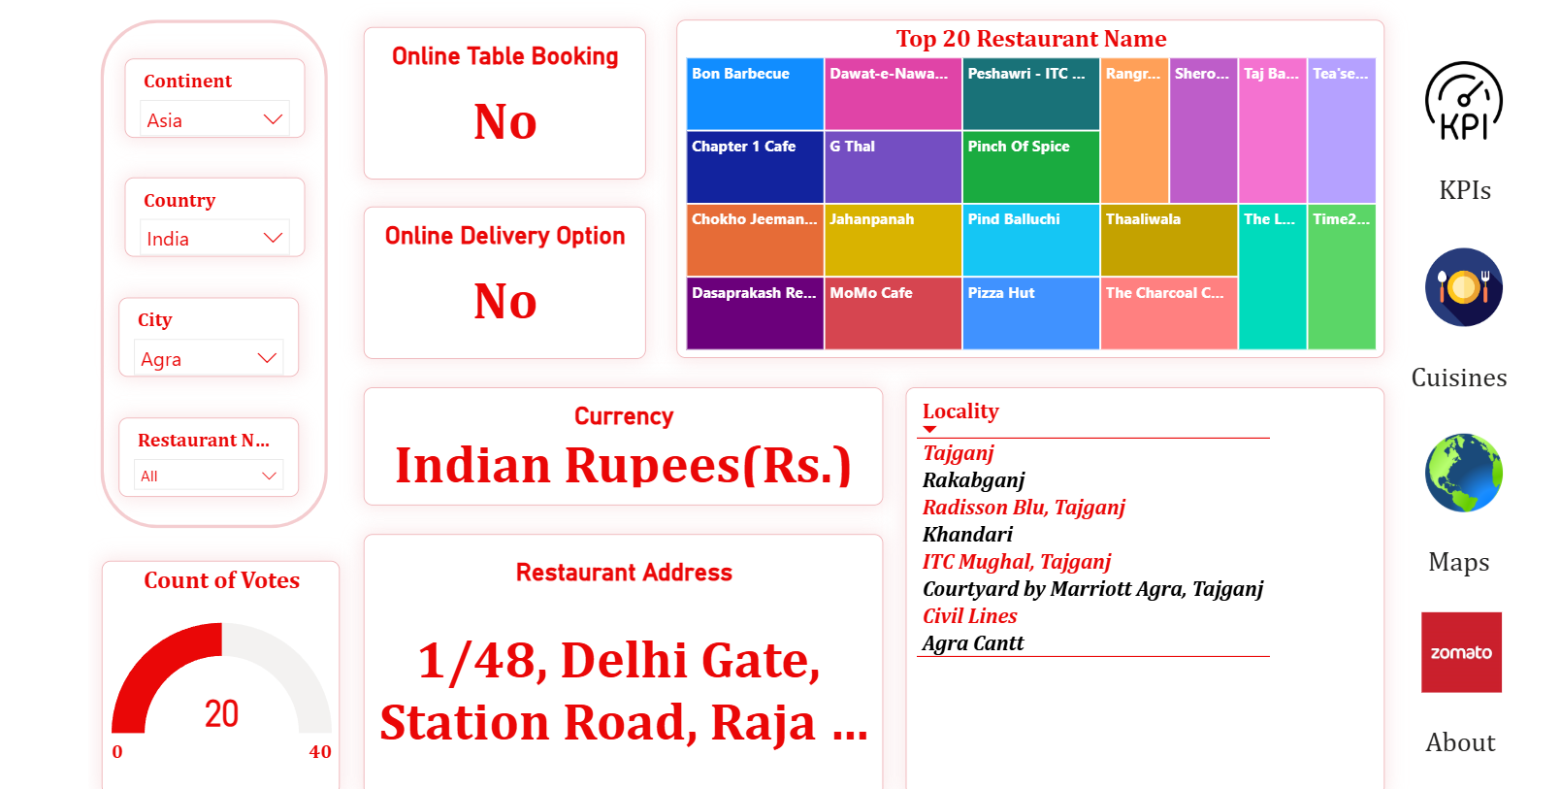
Restaurant and Service Analysis
This dashboard provides detailed information about restaurant services and customer engagement.
Key observations include:
• Most restaurants in the dataset do not provide online table booking. • Many restaurants do not support online delivery services. • The treemap visualization highlights the top 20 restaurants based on dataset analysis. • The dashboard also displays restaurant currency, locality, and address information.
Filters allow users to explore restaurant information based on continent, country, city, and restaurant name.

Slide 12
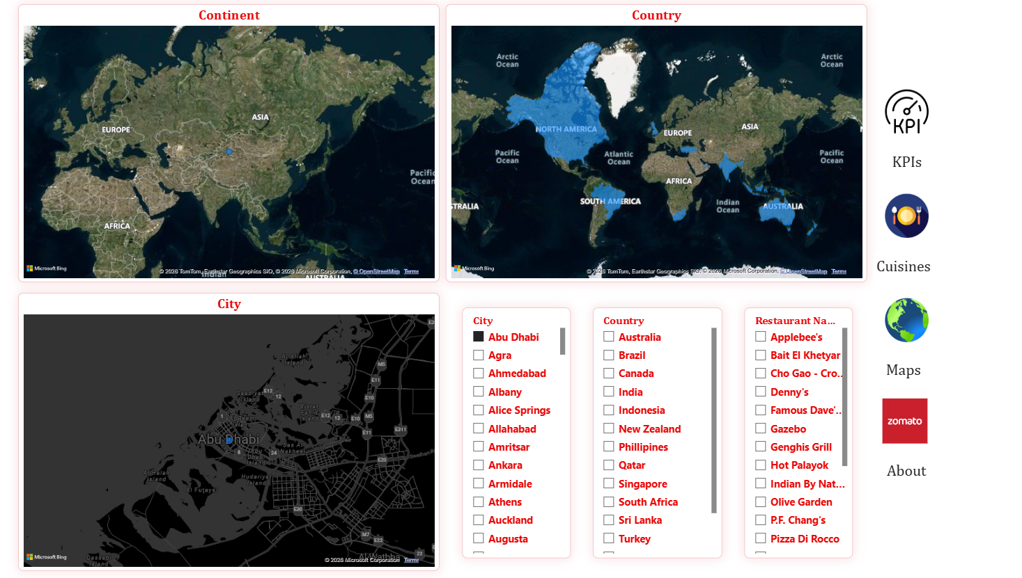
Geographical Distribution of Restaurants
The map visualization shows the geographical distribution of restaurants across different regions.
Key insights include:
• Restaurants are mainly located in Asia, particularly in India. • The map visualizations help identify restaurant presence by continent, country, and city. • Users can interact with the map to explore restaurant locations and distribution patterns. • Geographic insights help understand market concentration and regional restaurant trends.

Slide 13
Final Result
The project successfully analyzed the Zomato restaurant dataset using Microsoft Power BI and developed an interactive dashboard to visualize restaurant data.
The dashboard provides insights into restaurant ratings, cuisines, pricing trends, and geographical distribution.
Key outcomes of the project include:
• Identification of restaurant distribution across cities and regions. • Analysis of customer ratings and pricing patterns. • Visualization of popular cuisines and restaurant services. • Interactive dashboards that allow users to filter and explore data easily.
The developed Power BI dashboard transforms raw restaurant data into meaningful insights that support better decision-making and data analysis

Slide 14
Conclusion:
This project successfully analyzed the Zomato restaurant dataset and developed an interactive dashboard using Microsoft Power BI.
Through data cleaning, transformation, and visualization, the project converted raw restaurant data into meaningful insights that help understand restaurant performance and customer preferences.
Key Conclusions
• The analysis identified important trends in restaurant ratings, cuisines, pricing, and location distribution.
• Interactive dashboards allow users to explore data dynamically using filters such as city, country, cuisine, and restaurant name.
• The visualization helps highlight popular cuisines, restaurant pricing patterns, and customer rating trends.
• Map-based visualizations provide insights into the geographical distribution of restaurants.
Overall Outcome
The project demonstrates how business intelligence tools like Power BI can transform large datasets into clear and actionable insights, enabling better decision-making and understanding of restaurant market trends.

Slide 15
Future scope:
The current project focuses on analyzing restaurant data and visualizing insights using Microsoft Power BI. In the future, the system can be enhanced with advanced analytics and additional data sources.
Possible Improvements
1. Real-Time Data Integration The dashboard can be connected to live restaurant data to provide real-time updates on ratings, prices, and restaurant availability.
2. Predictive Analytics Machine learning models can be integrated to predict restaurant popularity, customer demand, and future rating trends.
3. Customer Sentiment Analysis Customer reviews can be analyzed using Natural Language Processing (NLP) to understand customer satisfaction and feedback.
4. Mobile Dashboard Access The dashboard can be optimized for mobile devices so users can access restaurant insights anytime.
5. Expanded Dataset More cities, restaurants, and additional attributes such as customer reviews, delivery time, and service quality can be included for deeper analysis.
6. Recommendation System An intelligent system can be developed to recommend restaurants based on user preferences, ratings, and cuisine choices.

Slide 16
References:
Zomato Restaurant Dataset used for data analysis and visualization.
Official documentation of Microsoft Power BI for dashboard creation and data visualization.
Microsoft Power Query documentation for data cleaning and transformation. DAX (Data Analysis Expressions) documentation for creating calculated measures and columns.
Online learning resources and tutorials for Power BI dashboard development.
Live Dashboard link:https://app.powerbi.com/view?r=eyJrIjoiNDk3YjM4ZDItZjRhNC00ZWIxLTgyODYtZWNkMmMyOTdjNGNhIiwidCI6ImM2ZTU0OWIzLTVmNDUtNDAzMi1hYWU5LWQ0MjQ0ZGM1YjJjNCJ9
Github Link:https://github.com/khanaffan21/Power-BI-Zomato-Analysis

Slide 17
Thank You

